Slide 1
GET TO KNOW UMKC ANEW
UMKC + HIGHER LEARNING COMMISSION TOWN HALL
Chancellor Agrawal, Provost Bichelmeyer
HLC Co-Chairs Cindy Pemberton and Ken Novak
Thursday, May 2, 2019

Slide 2
Welcome and Overview
Provost Barbara Bichelmeyer, Ph.D.

Slide 3
Why all the chairs and stage?
Pierson Hall is set up for a larger, state-wide event that almost directly follows this town hall.

Slide 4
Goals for Town Hall
Learn about the Higher Learning Commission and the institutional/regional accreditation process
Provide transparency to UMKC’s preparation for our 10-year comprehensive evaluation and site visit on December 2 & 3, 2019
Solicit feedback
Answer questions
Try to accomplish the above in as interactive manner possible

Slide 5
HLC Reaffirmation of Accreditation Co-Chairs
Cindy Pemberton, PhD
Deputy Provost, Office of the Provost and Executive Vice Chancellor
Professor, Counseling and Educational Psychology
Ken Novak, PhD
Professor, Department of Criminal Justice and Criminology

Slide 6
Warm-up Survey
Ken Novak

Slide 7

Smart phones out, when you see a QR code, aim the camera at it and answer the questions

Slide 8
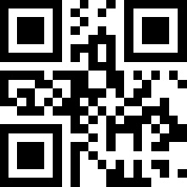
Text questions:
816.200.2307
Personal computing devices
on board
Or use camera to capture QR code
Try it now, it’s easy

Slide 9
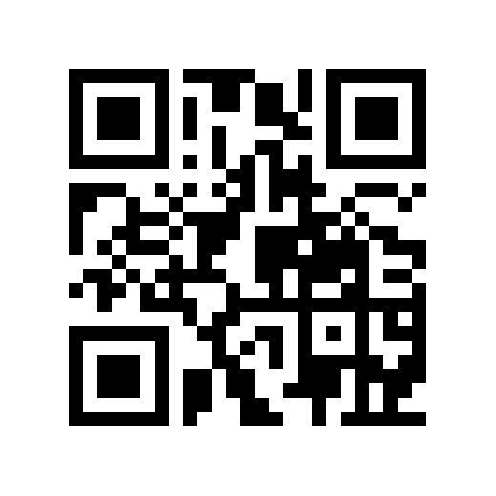
Survey: Have you ever participated in regional/institutional accreditation?

Slide 10
Survey results

Slide 11
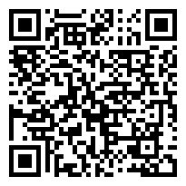
Survey: Have you ever participated in professional or discipline accreditation?
https://pingo.coactum.de/624240

Slide 12
Survey results

Slide 13
    Survey: How prepared do you think UMKC is for the HLC accreditation comprehensive evaluation? (type any word that comes to mind)
https://pingo.coactum.de/624240

Slide 14
Survey results

Slide 15
Higher Learning Commission Overview
Ken Novak

Slide 16

By a show of hands…
How many have participated in academic or discipline accreditation?
How many have been involved with institutional accreditation?
How are these similar? Different?

Slide 17
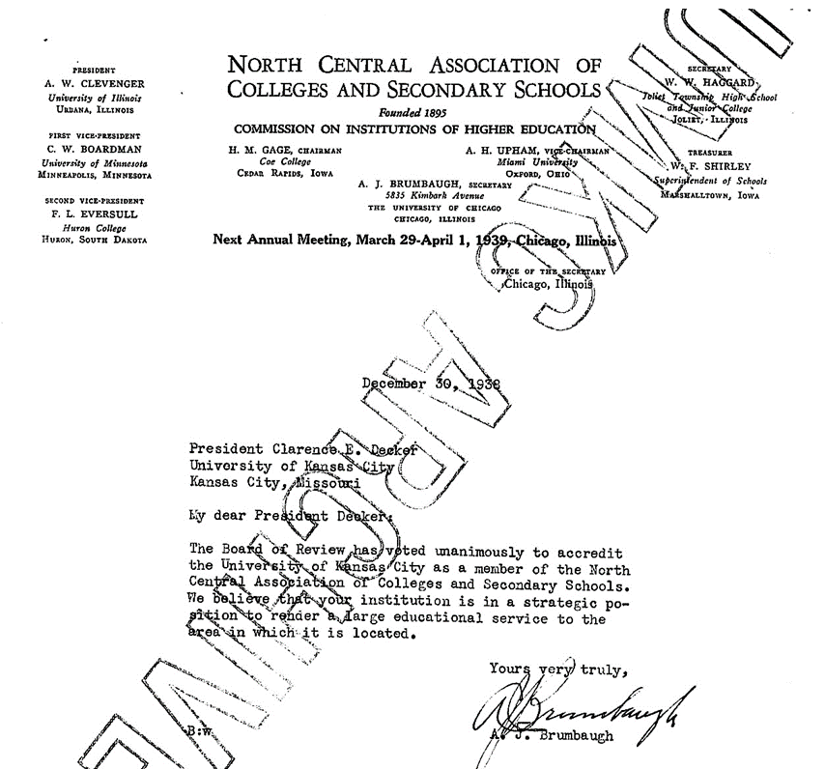
Accredited since 1938, and counting

Slide 18
HLC: What’s it all about?
10-year accreditation cycle
Verifying that institutions meet standards established by peers, evaluated by peers
Promoting institutional self-knowledge and advancement
Providing assurance to the public about quality
Building and maintaining confidence in higher education

Slide 19
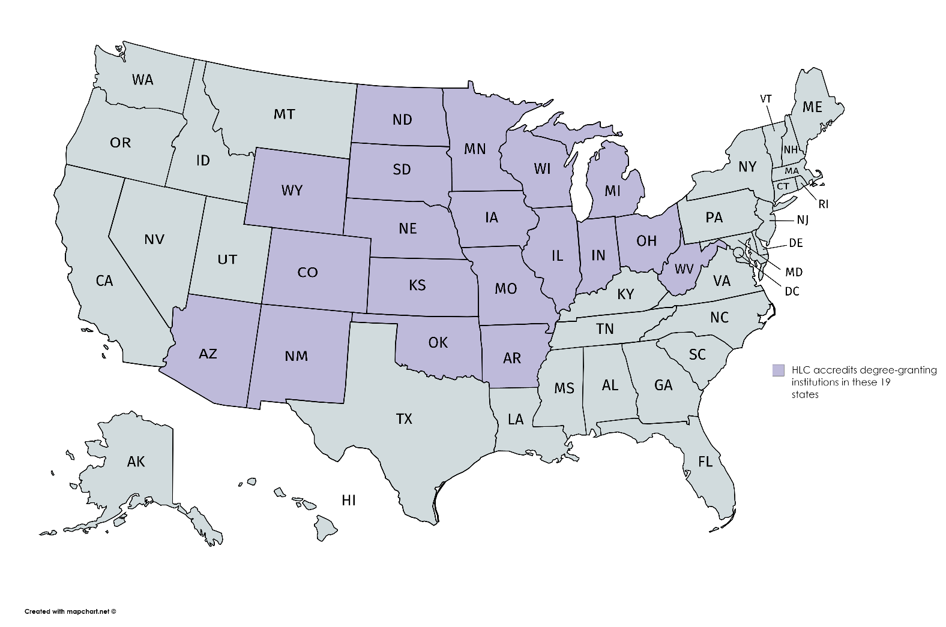
About the Higher Learning Commission
HLC is an independent corporation that was founded in 1895 as one of six regional institutional accreditors in the United States.
HLC accredits IHEs in 19 states

Slide 20
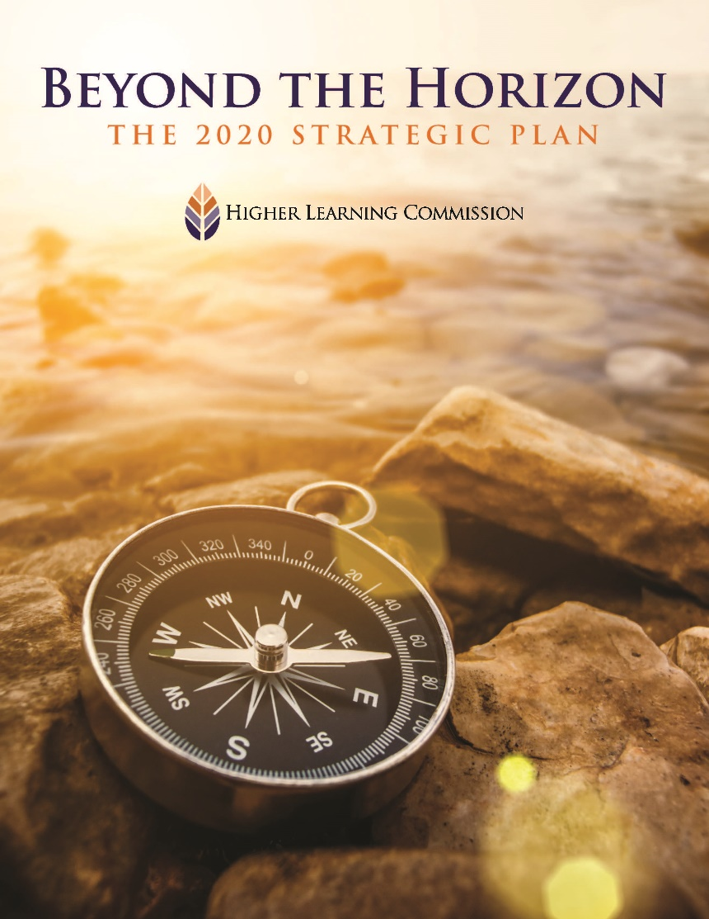
Higher Learning Commission Mission
“Serving the common good by assuring and advancing the quality of higher learning.”

Slide 21
HLC accreditation process changes with the times

Slide 22
Guiding Values - unpacked
Focus on student learning
Education as a public purpose
Education for a diverse, technological, globally connected world
A culture of continuous improvement
Evidence-based institutional learning and self-presentation
Integrity, transparency, and ethical behavior or practice
Governance for the well-being of the institution
Planning and management of resources to ensure institutional sustainability
Mission-centered evaluation
Accreditation through peer review

Slide 23
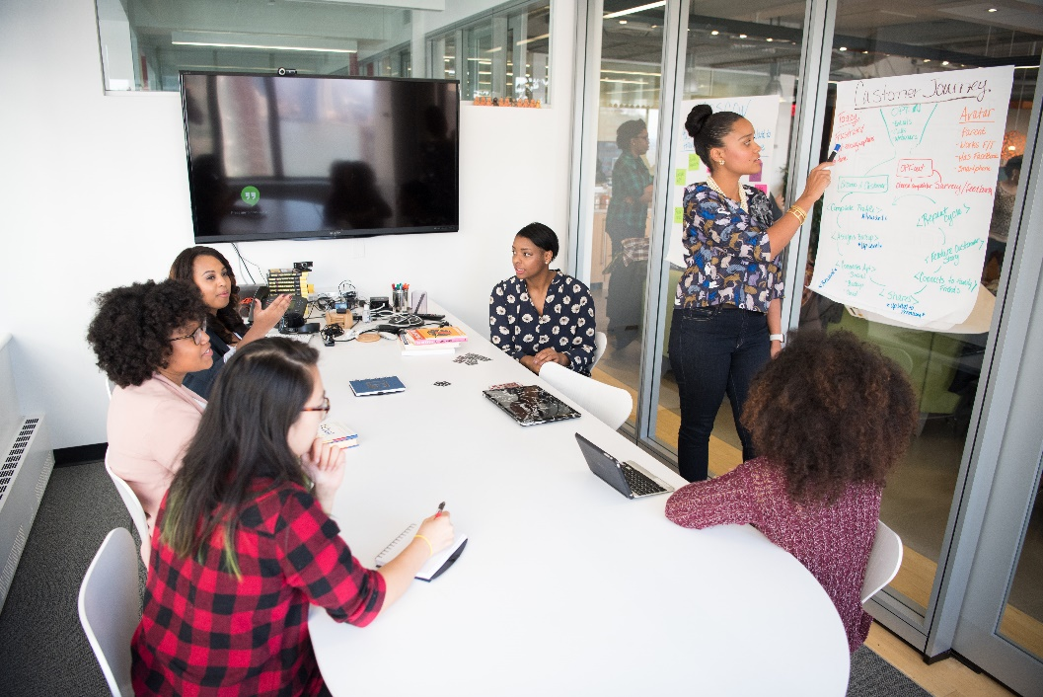
Student learning – education- serves a public purpose
Regards teaching mission of any institution as primary
“What the students buy, with money, time and effort, is not merely a good, like a credential, but experiences that have the potential to transform lives or harm them.”
Notes:
1. Focus on student learning
For the purpose of accreditation, the Higher Learning Commission regards the teaching mission of any institution as primary. Institutions will have other missions, such as research, health care and public service, and these other missions may have a shaping and highly valuable effect on the education that the institution provides. In the accreditation process, these missions should be recognized and considered in relation to the teaching mission.
A focus on student learning encompasses every aspect of students’ experience at an institution: how they are recruited and admitted; costs they are charged and how they are supported by financial aid; how well they are informed and guided before and through their work at the institution; the breadth, depth, currency and relevance of the learning they are offered; their education through cocurricular offerings; the effectiveness of their programs; and what happens to them after they leave the institution.
2. Education as a public purpose
Every educational institution serves a public purpose. Public or state-supported institutions make that assumption readily. Not-for-profit institutions receive their tax-exempt status on the basis of an assumption that they serve a public purpose. And although it may appear that a for-profit institution does not require a public purpose, because education is a public good its provision serves a public purpose and entails societal obligations. Furthermore, the provision of higher education requires a more complex standard of care than, for instance, the provision of dry cleaning services. What the students buy, with money, time and effort, is not merely a good, like a credential, but experiences that have the potential to transform lives, or to harm them. What institutions do constitutes a solemn responsibility for which they should hold themselves accountable.

Slide 24
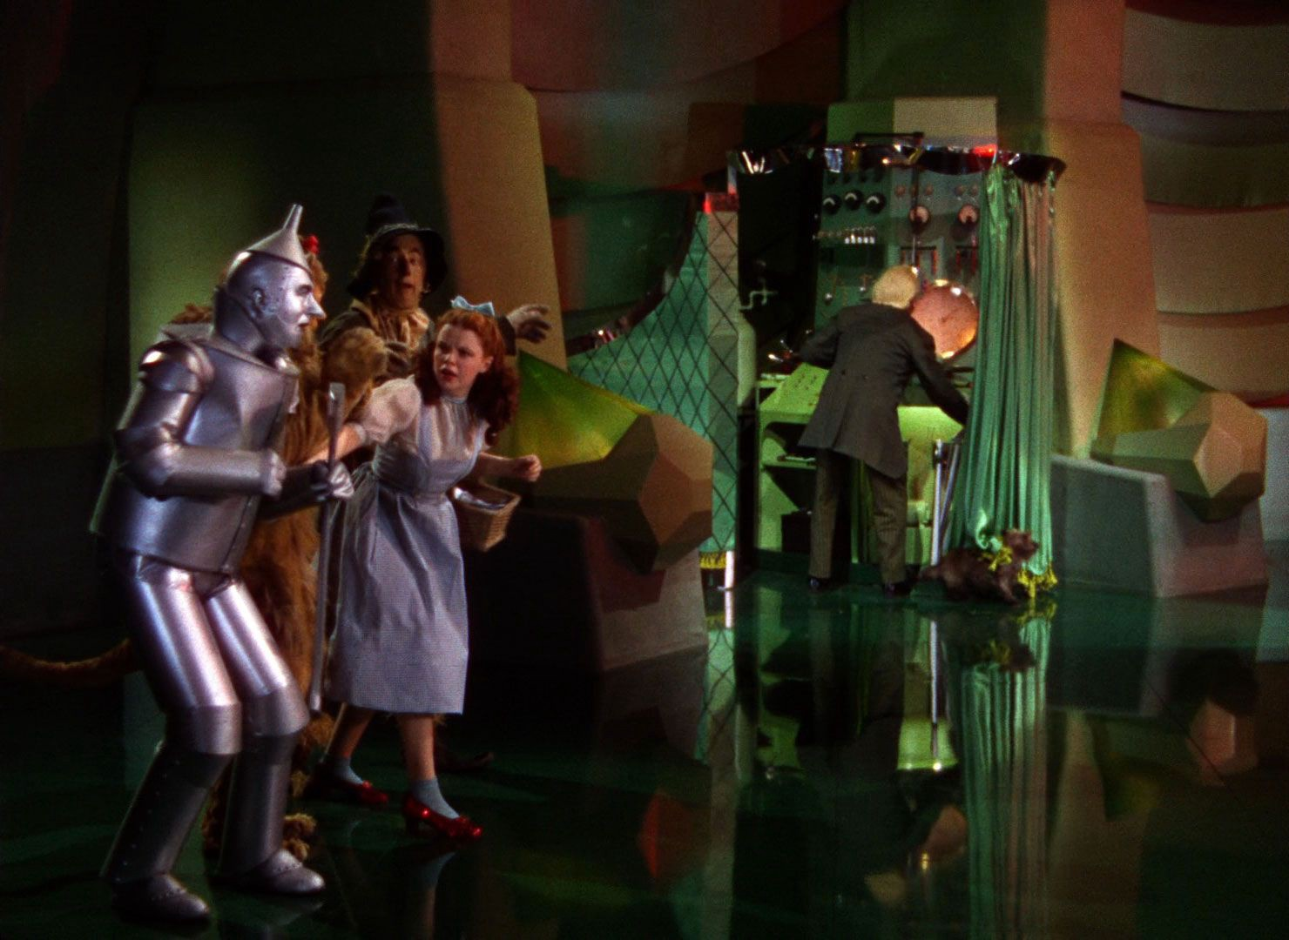
Continuous improvement, the (not so) hidden curriculum of HLC
A culture of continuous improvement
Evidence-based institutional learning and self-presentation
Notes:
4. A culture of continuous improvement
Continuous improvement is the alternative to stagnation. Minimum standards are necessary but far from sufficient to achieve acceptable quality in higher education, and the strongest institutions will stay strong through ongoing aspiration. HLC includes improvement as one of two major strands in all its pathways, the other being assurance that member institutions meet the Criteria and the Federal Requirements.
A process of assessment is essential to continuous improvement, and therefore a commitment to assessment should be deeply embedded in an institution’s activities. Assessment applies not only to student learning and educational outcomes but to an institution’s approach to improvement of institutional effectiveness.
For student learning, a commitment to assessment would mean assessment at the program level that proceeds from clear goals, involves faculty at all points in the process, and analyzes the assessment results; it would also mean that the institution improves its programs or ancillary services or other operations on the basis of those analyses. Institutions committed to improvement review their programs regularly and seek external judgment, advice or benchmarks in their assessments. Because in recent years the issues of persistence and completion have become central to public concern about higher education, the current Criteria direct attention to them as possible indicators of quality and foci for improvement, without prescribing either the measures or outcomes.
Innovation is an aspect of improvement and essential in a time of rapid change and challenge; through its Criteria and processes HLC seeks to support innovation for improvement in all facets of institutional practice.

Slide 25

Accreditation through peer review
Requirements of peer review to minimize public skepticism
Collegial
Openness in the relationship between an institution and peer reviewers
Maintain high standards
Assure and advance quality
Notes:
Having evidence is critical for quality assurance purposes of accreditation
Integrity means being mission focused
Governance systems focus on welfare of the institution and its students
No intentional misleading statements or practices
Fully disclose information to students before students matriculate
Clear, explicit requirements for ethical practice by all

Slide 26
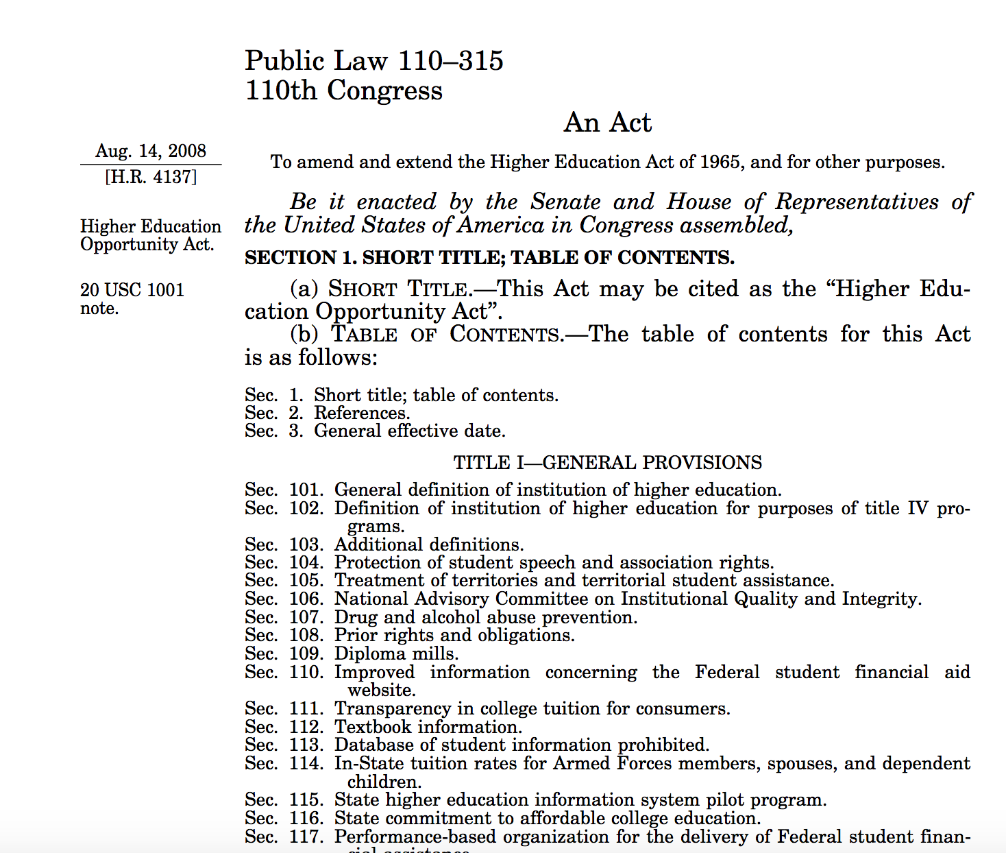
HLC and Department of Education
HLC is required to assure that all of its member institutions comply with federal regulations.

Slide 27
UMKC’s HLC Accreditation Preparation
Ken Novak

Slide 28
Speaking HLC’s language
Comprehensive evaluation
  Confirms that the institution continues to meet the Criteria for Accreditation, is pursuing institutional improvement and complies with requirements sets by the U.S. Department of Education.
  Evaluations are conducted by teams of peer reviewers.
Assurance argument
  Narrative that builds the case for how the institution meets criteria for accreditation – limit 35,000 words
Evidence
  Organizational artifacts that support claims offered within the assurance argument
  We may not be able to include all evidence, but what we don’t include may be useful for the site visit

Slide 29
Criteria
Co-Chair Reflections
Brief synopsis of:
What is UMKC doing really well?
What areas still need attention?
Mission
Integrity: Ethical and Responsible Conduct
Teaching and Learning: Quality, Resources & Support
Teaching and Learning: Evaluation and Improvement
Resources, Planning, & Institutional Effectiveness
Federal Compliance
Notes:
Criterion One. Mission
The institution’s mission is clear and articulated publicly; it guides the institution’s operations.
Criterion Two. Integrity: Ethical and Responsible Conduct
The institution acts with integrity; its conduct is ethical and responsible.
Criterion Three. Teaching and Learning: Quality, Resources, and Support
The institution provides high quality education, wherever and however its offerings are delivered.
Criterion Four. Teaching and Learning: Evaluation and Improvement
The institution demonstrates responsibility for the quality of its educational programs, learning environments, and support services, and it evaluates their effectiveness for student learning through processes designed to promote continuous improvement.
Criterion Five. Resources, Planning, and Institutional Effectiveness
The institution’s resources, structures, and processes are sufficient to fulfill its mission, improve the quality of its educational offerings, and respond to future challenges and opportunities. The institution plans for the future.

Slide 30
CR 1: Mission
Where UMKC is doing well
UMKC’s new mission and vision statements have been approved and have sparked campus wide discussions
Faculty, staff, and administrators are proud to contribute to a student-centered urban university and fulfill our purpose of learning, discovery, research, and service, inspired by our commitment to equity, diversity, inclusion, and respectful interaction.
Where UMKC’s challenges remain
Higher education in Missouri faces significant competitive and financial pressures
  E.G., shrinking revenues, heightened focus on workforce development, higher expectations for return on investment, changing expectations about personalization and engagement, more aggressive competition, and greater accountability

Slide 31
CR 2 – Integrity: Ethical & Responsible Conduct
Where UMKC is doing well
External Mock Review: “Overall . . Two [is] very much on target”
CRR: Ethics, Academic Freedom, Faculty Standards of Conduct
Statement of Values, Mission, Vision, Strategic Plan
Where UMKC’s challenges remain
Conflict of Interest processes

Slide 32
CR 3: Teaching and Learning Quality, Resources, & Support
Where UMKC is doing well
Diversity and Inclusion
Student Engagement
Faculty
Where UMKC’s challenges remain
Student-Faculty Engagement
Making sure that we are all on the same page

Slide 33
CR 4: Teaching & Learning: Evaluation and Improvement
What are we doing well?
  Maintaining specialized accreditations – all our individually-accredited programs are in good standing;
  Exercising authority over pre- and co-requisites, particularly since our recent completion of degree audits;
  Dual-Credit Program; and Transfer-Credit Evaluation Process
What are our challenges moving forward?
  Academic Program Review & Assessment of Student Learning
  Improving education through our attention to retention, persistence, and completion rates
  Evaluation of Graduate Success

Slide 34
CR 5 – Resources, Planning & Institutional Effectiveness
Where UMKC is doing well
  New Strategic Plan and alignment with fiscal management
  New Resource Investment Model and associated “Rules, Roles and Responsibilities” to provide higher level of financial accountability
  Academic Portfolio Review and Administrative Services Review
  Shared Governance
Where UMKC’s challenges remain
  Challenges created by declining State budget support and the stress this places on meeting our academic mission
  Growing and retaining undergraduate students
  Support for research
  Lack of documentation of meetings, policies and processes

Slide 35
Key Benchmarks Met
Date | Activities
August 2017 | Initiate process
Fall 2017-Spring 2018 | Draft assurance argument; identification and collection of evidence
Summer 2018 | Revise assurance argument; categorize and warehouse evidence; editing
Fall 2018 | Desk review by 3rd party
December 2018 | Receive reviewers’ comments
Spring 2019 | Revision of AA, Evidence

Slide 36

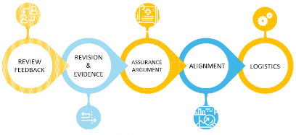
2019 HLC TIMELINE
REVISION & EVIDENCE
Criterion Committees submit new evidence by 1 March 2019
SITE VISIT
Student Success Plan Forums
2-3 December 2019
2
6
Faculty Senate update 19 Feb 2019
HLC Town Hall #1
6 March 2019
ARGUMENT
3
Steering Committee meeting 4 February 2019
1 Nov 2019
Criterion Committees submit revised assurance argument by 1 April 2019
1
5
REVIEW
HLC Town Hall #2
2 May 2019
LOGISTICS
HLC Co-Chairs send consultant feedback
Student survey mid-Sept 2019
4
ALIGNMENT
AA + FC in HLC System 1 Sept 2019
2 Jan 2019

Slide 37
How to participate moving forward
FS19 - Open forums in preparation for site visit
  Mission & Integrity
  Teaching & Learning
  Resources & Institutional Effectiveness
“Road Show”
Feedback
Site visit – December 2-3

Slide 38
Thank you!
Cain, Ruth
Cary, Ann
Cattaneo, Raymond
Cole, Maria
Cornell, David
Cox, Kelli
Dreyfus, Lawrence
Elliott, Brandie
Everett, William (Bill)
Filion, Diane
Goodenow, Andy
Gormley, Sheri
Graham, Maqual
Herron, John
Hintz, Carol
Holt, Lorie
Horsmon, Caitlin
Johnson, Mark
King, Greg
King, Makini
Korkmaz, Ali
Kurup, Vishal
Laurent, Scott
Lillebo, Troy
Lindenbaum, Sharon
Marken, Trish
McKusick, James
McNeley, Kim
Mebane, Carla
Melchert, Russ
Mitchell, Linda Perry, Justin
Prettejohn, Amy
Quaintance, Jennifer
Reed, Aaron
Schlein, Candace
Soder, Aidan
Spenner, Anne
Swink, Doug Vaught, Wayne
Waddell, Jennifer
Ward-Smith, Peggy
Weddle, Dan
Wells, Todd
Wilkerson, Karen
Wilson, Carla
Wilson, Jay
Wilson, Susan
Wyatt, Sybil
Young, Scott

Slide 39
Getting to know UMKC
Provost Bichelmeyer

Slide 40
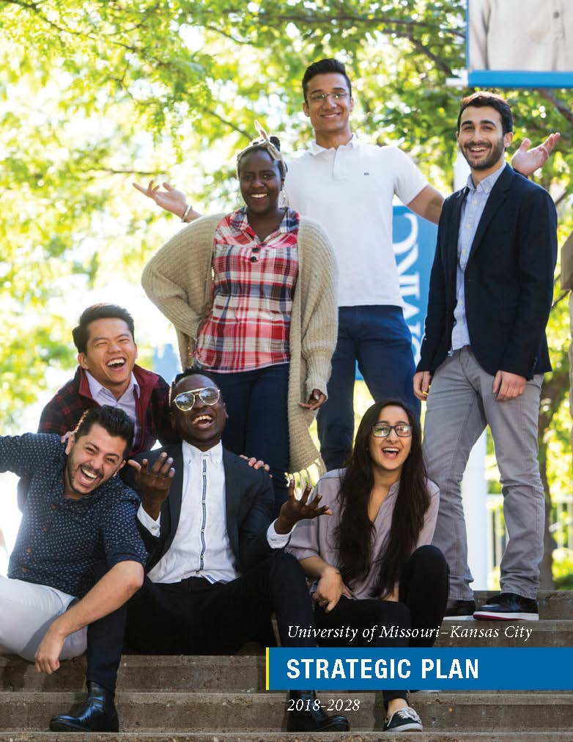
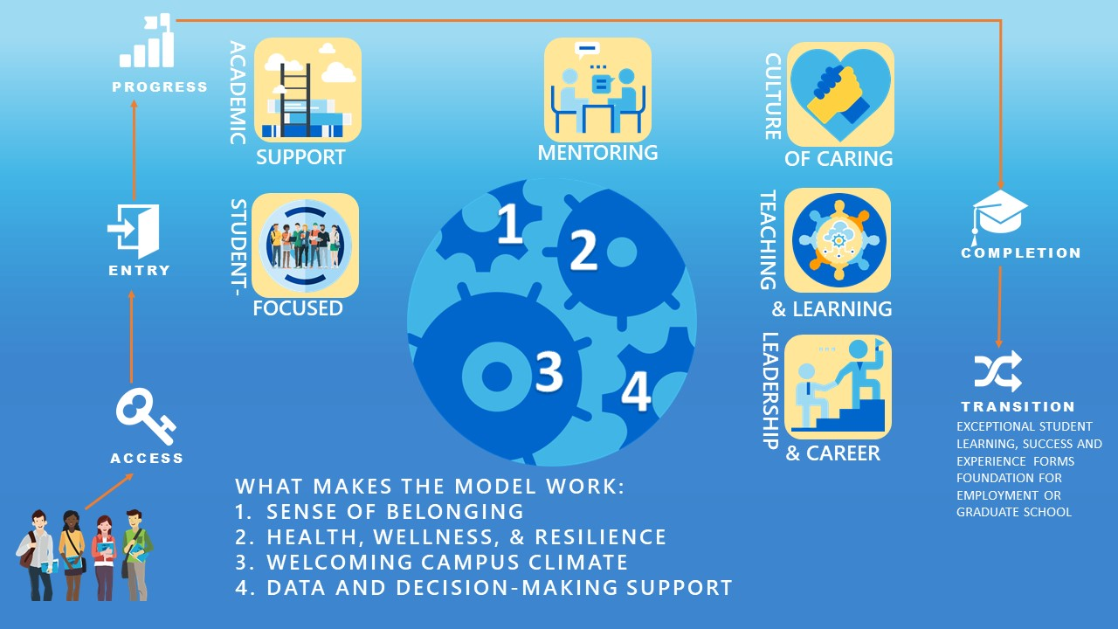
Connection with Strategic Plan and Student Success Model

Slide 41
Mission
As an urban research university, the mission of the University of Missouri-Kansas City (UMKC) is to promote learning through the discovery, preservation and dissemination of knowledge of public value across a broad spectrum of disciplines and fields of study.
UMKC celebrates the individual and embodies diversity and inclusion by intertwining these goals with innovation to enable transformational societal impact aimed at bringing cultural, social, health and economic prosperity to the metropolitan, regional and global communities it serves.

Slide 42

Strategic Plan Pillars - Overview
Provide exceptional student learning, success and experience
Become a thriving discovery enterprise
Transform our community and region with impactful engagement
Foster an environment of invigorating multiculturalism, globalism, diversity and inclusion
Develop a strong and resilient people, process and physical infrastructure
FOUNDATIONAL COMMITMENT TO OUR PEOPLE

Slide 43
UMKC Needs a Student Success Model
UMKC has a moral imperative to increase our retention, persistence, and completion rates.
Student success is everyone’s responsibility.
Nationally enrollment in higher education is in historic decline. We need to work smarter and harder to reach our persistence goals.
Student Success Model drives resources and investments to increase student outcomes.

Slide 44


Creating a Culture of Care
We meet each student exactly where they are.
We assess but don’t assume or judge.
We treat students as our family.
We engage each student with learning experiences and co-curricular supports to meet their unique needs.
We provide each student with constant and consistent guidance and feedback.
We help each student take responsibility for their personal progress, their education, their decisions, and their futures.
We encourage each student to fully integrate their individual growth with the common good.
We are proud to contribute to a student-centered urban university, serving our mission of learning, discovery, research and service, inspired by our commitment to equity, diversity, inclusion, and respectful interaction.

Slide 45
UMKC’S Student Success Foundation
Compelling connection of caring and inclusion that inspires student engagement.
Equitable access to UMKC’s academic and co-curricular programs and services.
Shared growth mindset, learning, discovery and innovation.
Purpose, empowerment, self-regulation, commitment and resilience that promotes persistence through degree completion and alumni engagement.
Timely completion of a rigorous academic program of study at the lowest possible cost.
Ready and well-prepared alumni for independence, career, advanced study, and leadership.
Patton, L. D., Renn, K. A., Guido, F. M., & Quaye, S. J. (2016). Student development in college: Theory, research, and practice. John Wiley & Sons.

Slide 46
What makes you proud of UMKC?
Microphone or text to 816.200.2307

Slide 47
What can you do to engage with HLC accreditation and our comprehensive evaluation?
Microphone or text to 816.200.2307

Slide 48
Get to know UMKC anew
Read the Strategic Plan
Participate in your unit’s strategic planning process
Read the Student Success Model
Talk with students about HLC
Want to read the draft assurance argument? Email Alexis Petri at petria@umkc.edu

Slide 49
Remarks from Chancellor
Chancellor C. Mauli Agrawal, Ph.D.

Slide 50
Questions? microphone or text
816.200.2307
Notes:
Proposed Draft Agenda for Student Success Roll-Out

Slide 51
Thank you!
Cindy Pemberton – PembertonC@umkc.edu
Ken Novak – NovakK@umkc.edu
Notes:
Proposed Draft Agenda for Student Success Roll-Out

