Slide 1
How Digital Literacy for ELL Parents Improves Parent Involvement
Linda Innes, Center School District

Slide 2
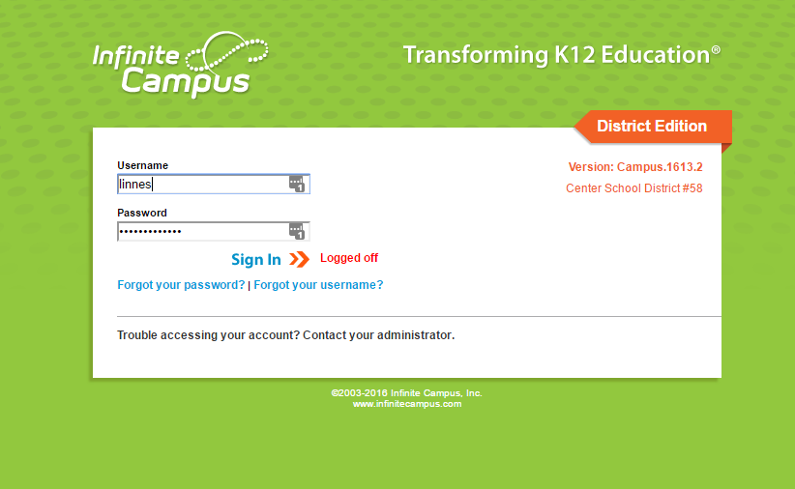
The Electronic World vs ELL Parents
Center School District uses the web-based program Infinite Campus to log ALL information about students.
ELL parents do not know how to find this program, how to log into it, or how to navigate it.

Slide 3
District Calendars & Boundary Map
At Center there is a district calendar and separate calendars for every school building.
How would an ELL parent know how to navigate to all of those different calendars?
District boundaries are all over the place and all parents struggle to know what property is within the district boundary lines.
How would an ELL parent understand these documents?

Slide 4
Students to the Rescue!
Problem: Parents who are limited in English and not very tech savvy need to be able to access student information online.
Solution: High school ELL students who know how to:
log into Infinite Campus & find the district website,
navigate both systems,
speak the native language, and
are comfortable with technology.

Slide 5
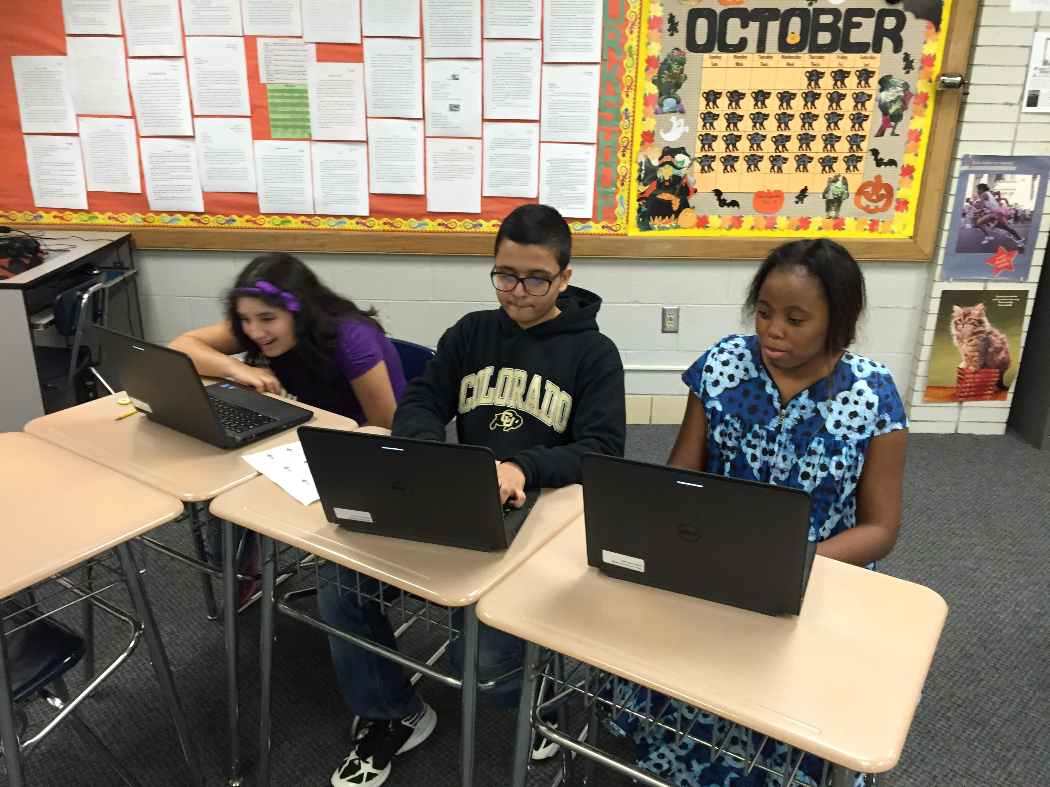
Preparation for the Training of Parents
Parent logins to Infinite Campus were organized so students could easily access them.
Documents were created in English/Spanish for parents to take home.
Secondary ELL students practiced what they would do with parents at the ELL activity night.

Slide 6
Show Time @ ELL Family Thanksgiving
Annually the ELL Department organizes an ELL Family Thanksgiving potluck. After we eat, the little ones are corralled and entertained in the gym by two ELL teachers.
Parents, high school ELLs, and two ELL teachers proceed to the computer lab to learn how to access grades, district and school calendars, and school boundary information.

Slide 7
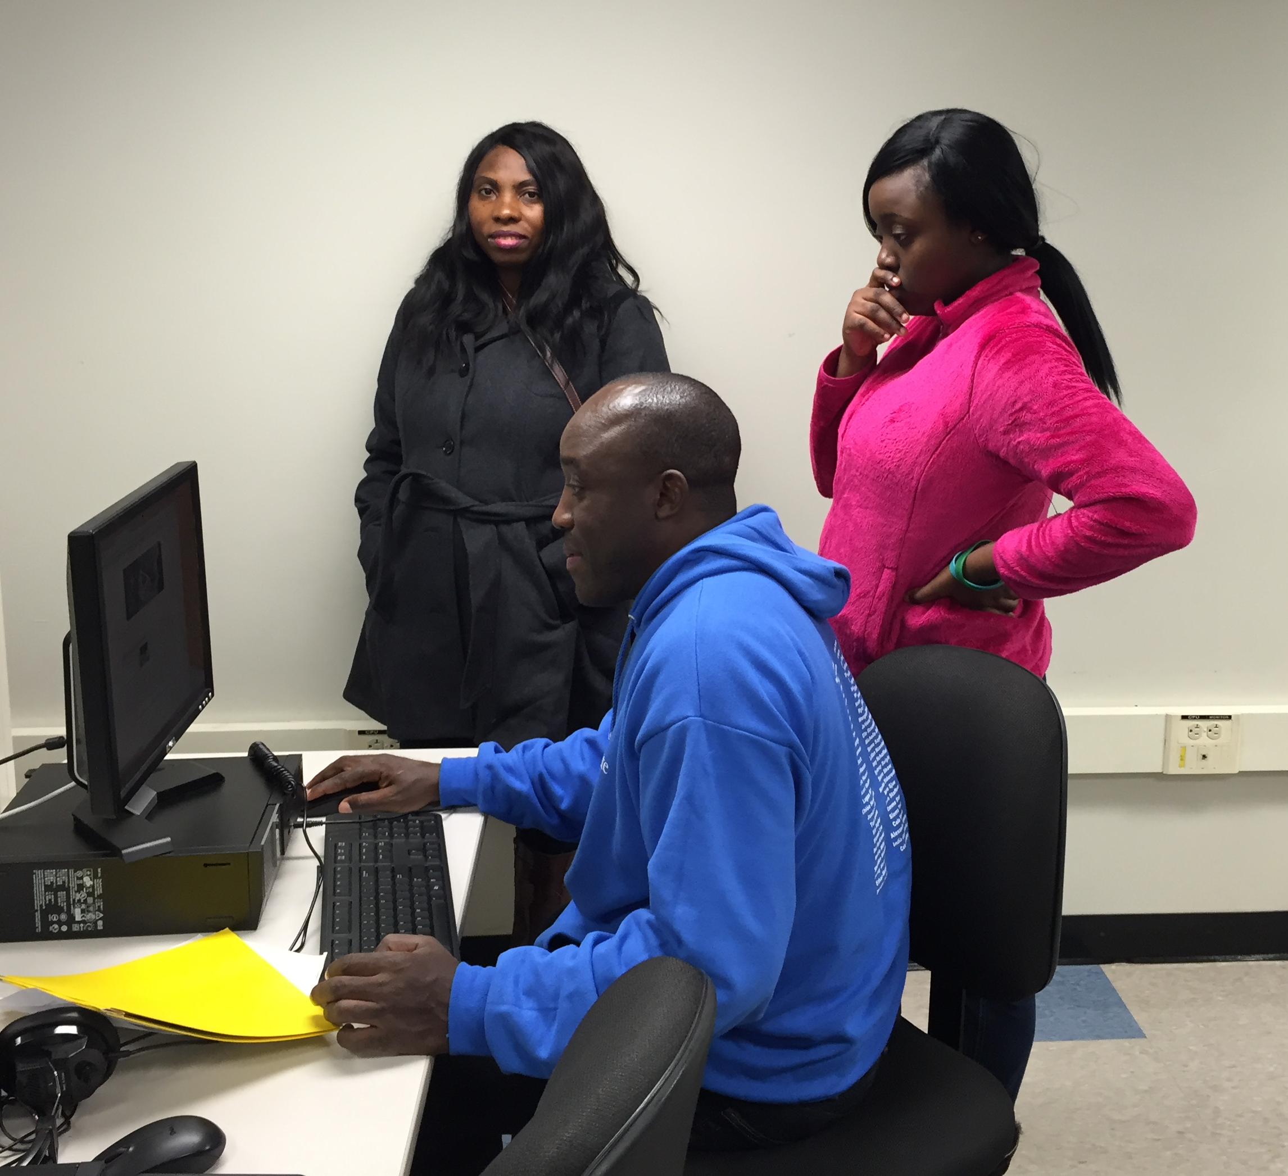
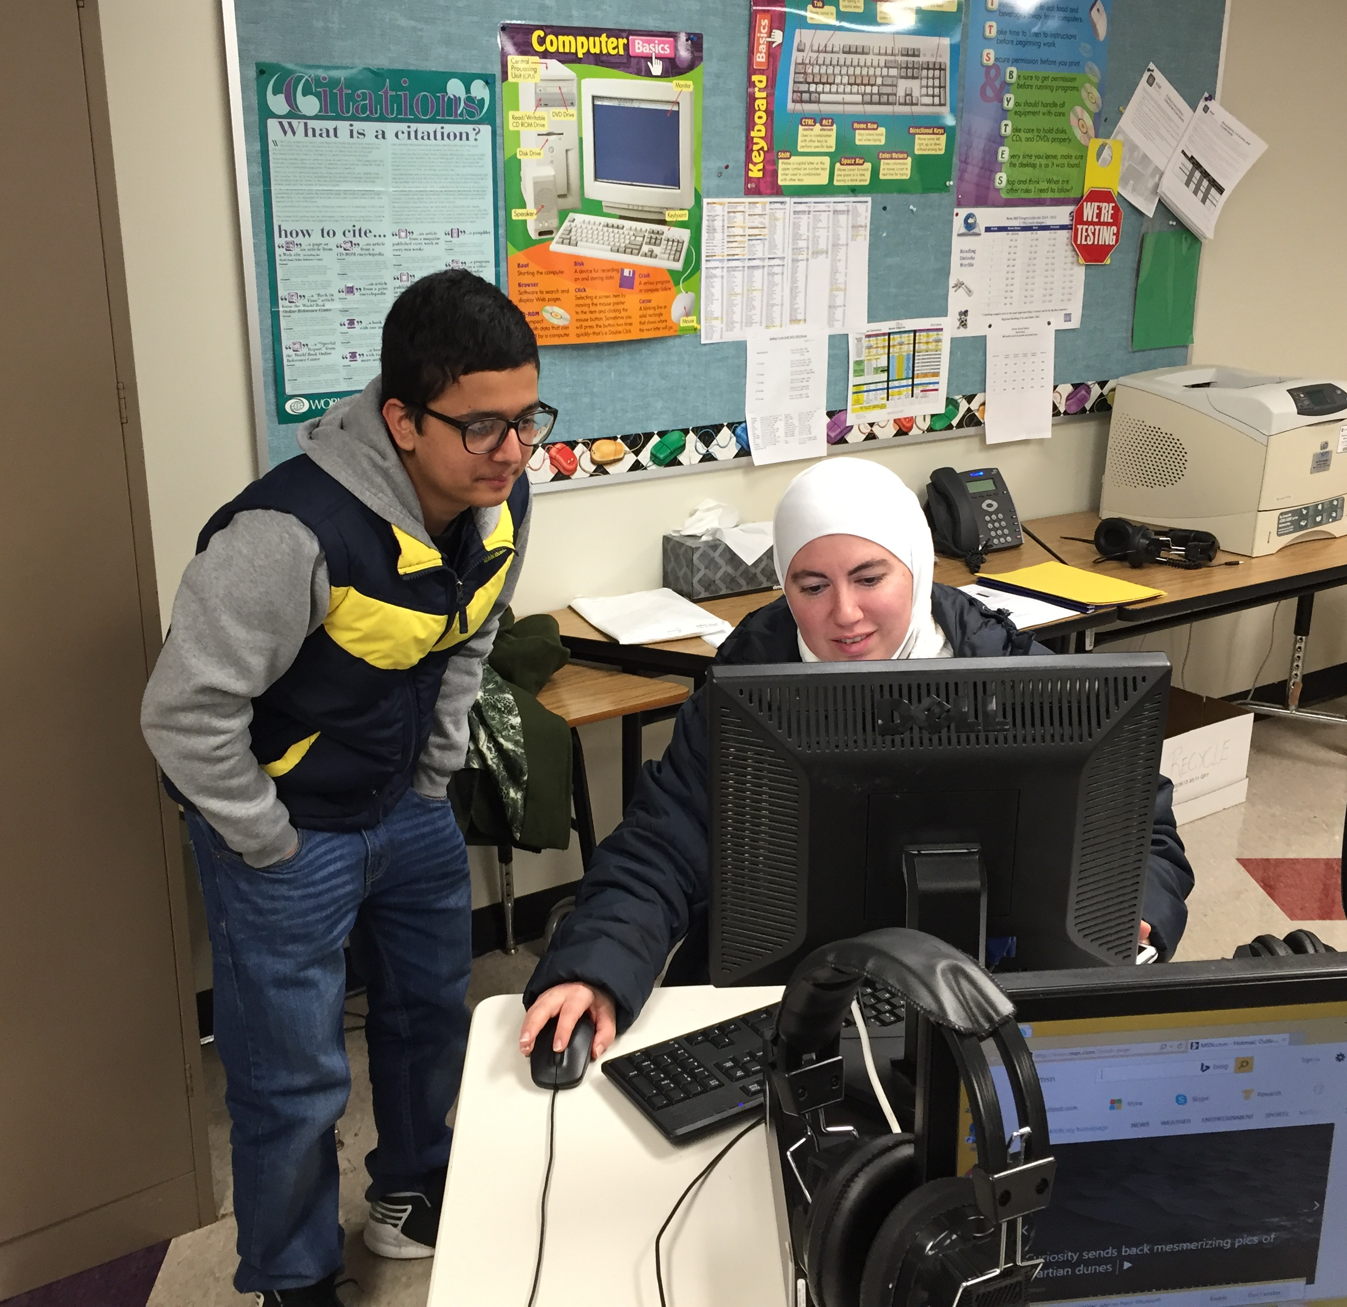
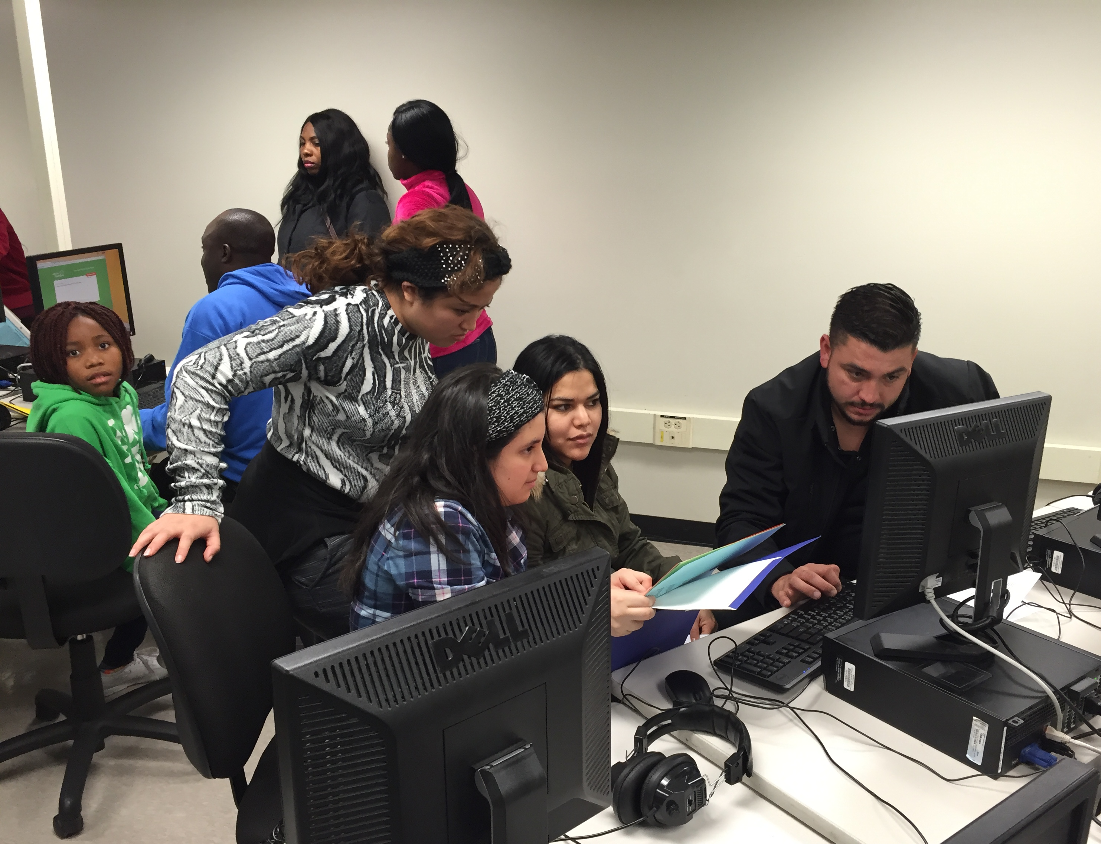
Meanwhile, in the computer lab…

Slide 8
Here’s the Center ELL Team
Linda Innes
Nicole Collins
Mary O’Leary
Cayetana Maristela

